Slide 1
Machine learning

Slide 2
Definition
Machine learning is a branch of artificial intelligence (AI) focused on building applications that learn from data and improve their accuracy over time without being explicit programmed.

Slide 3
Procedure of training ML model
Data acquiring: gather data from different source
Data preprocessing: process data so it can be applicable on ml algorithms
Define: What type of model will it be? A decision tree? Some other type of model? Some other parameters of the model type are specified too.
Fit: Capture patterns from provided data. This is the heart of modeling.
Predict: make multiple predication.
Evaluate: Determine how accurate the model's predictions are.

Slide 4
Type of learning
Supervised :- all data are labeled, used for regression and classification prediction
Unsupervised :- data are not labeled, used in clustering.
Semi- Supervised:- few data are labeled and few are unlabeled data.
Reinforcement learning:- Reinforcement learning (RL) is an area of machine learning concerned with how intelligent agents ought to take actions in an environment in order to maximize the notion of cumulative reward. Reinforcement learning is one of three basic machine learning paradigms, alongside supervised learning and unsupervised learning.

Slide 5
Training , test , validation
Training Dataset:- Training datasets are data that used to train our model.
Testing Dataset:-This dataset are data that model has never seen before Test data are testing purpose. Here we evaluate model accuracy and decide weather model is useful in real life or not.
Validation dataset:- validation data is use for hyper parameter tuning of model.

Slide 6
Training accuracy and validation accuracy
Training acc:- Training accuracy is accuracy that model acquire during training procedure.
Test acc:- test accuracy Is real accuracy in which we can say how our model perform in real world.

Slide 7
Overfitting and under fitting
Overfitting means our model has focused on the particular training set so much that it has missed the point entirely. In this way, the model is not able to adapt to new data as it’s too focused on the training set. (Train acc too high and val acc low)
Under fitting, on the other hand, means the model has not captured the underlying logic of the data. It doesn’t know what to do with the task we’ve given it and, therefore, provides an answer that is far from correct.(Train acc too low)

Slide 8
Variance and biased
Bias is considered a systematic error that occurs in the machine learning model itself due to incorrect assumptions in the ML process.
variance is the difference between the actual samples of the dataset and the predictions made by the model. correct assumptions in the ML process.

Slide 9
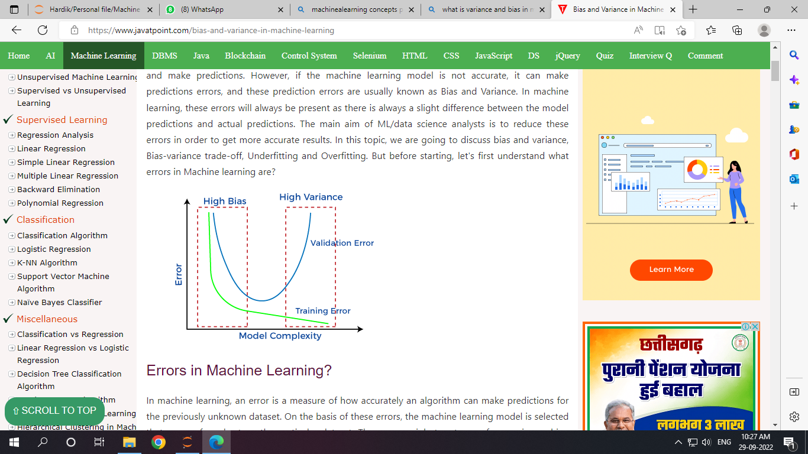
Over fit
High variance
low bias
Under fit
High variance
high bias
Generalize model
Low variance
Low bias

